Slide 1
Marshall Data Analytics Competition
Karen He, Aditi Singh

Slide 2
Business Question
What are some factors that affect Estimated Time of Journey?

Slide 3
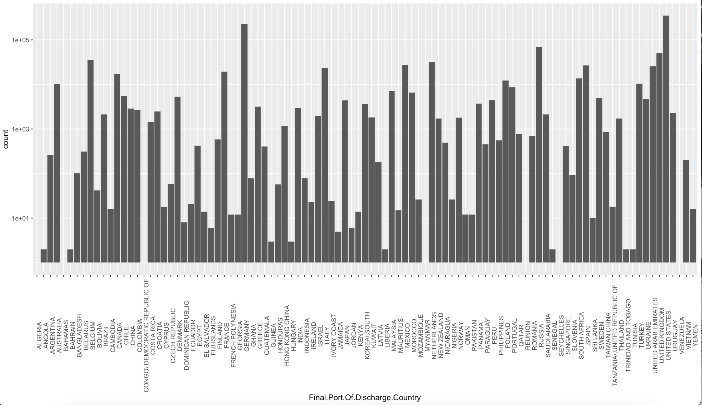
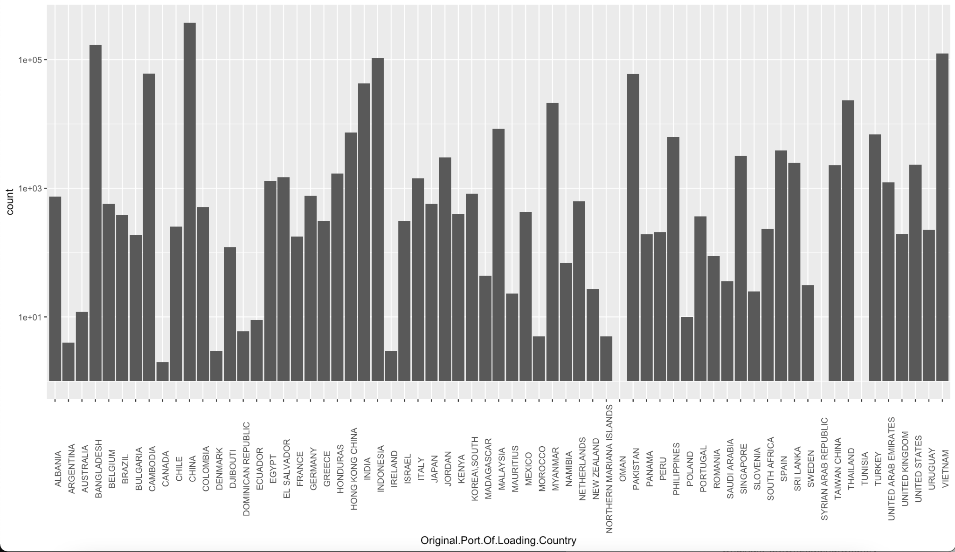

Slide 4
Narrowing the Scope:
Chose US and China Relations - USA imports the most from China
Original Port: China
Final Port: USA
Chose to look at Consignee as our main variable - Homegoods and Home Depot USA vs all else
How it affects Estimated Time of Journey

Slide 5
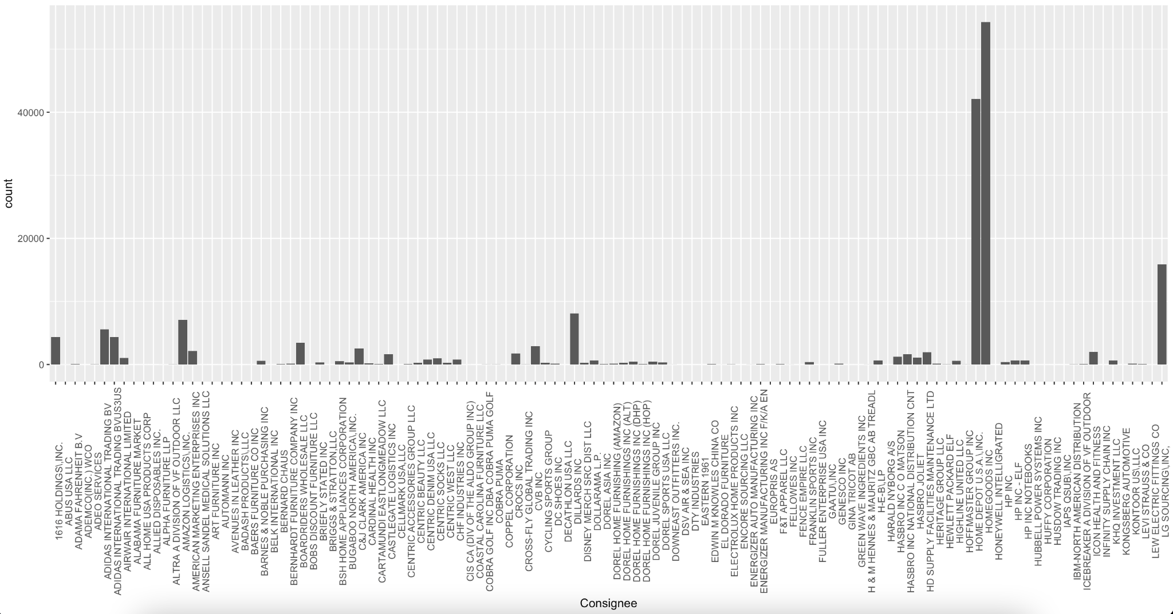

Slide 6
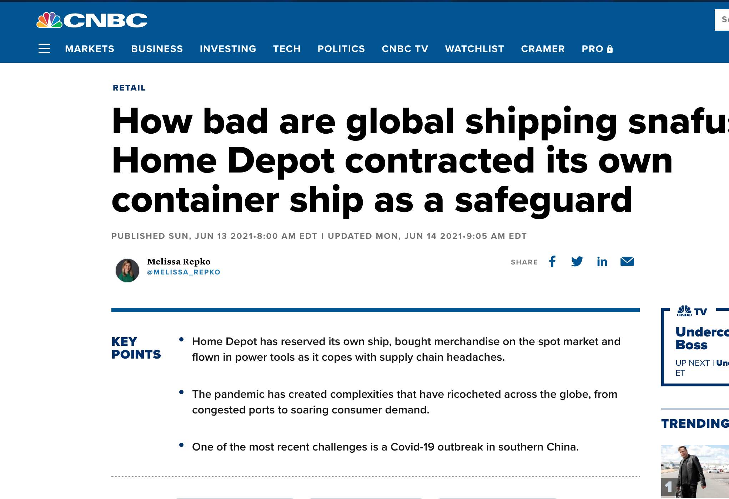

Slide 7
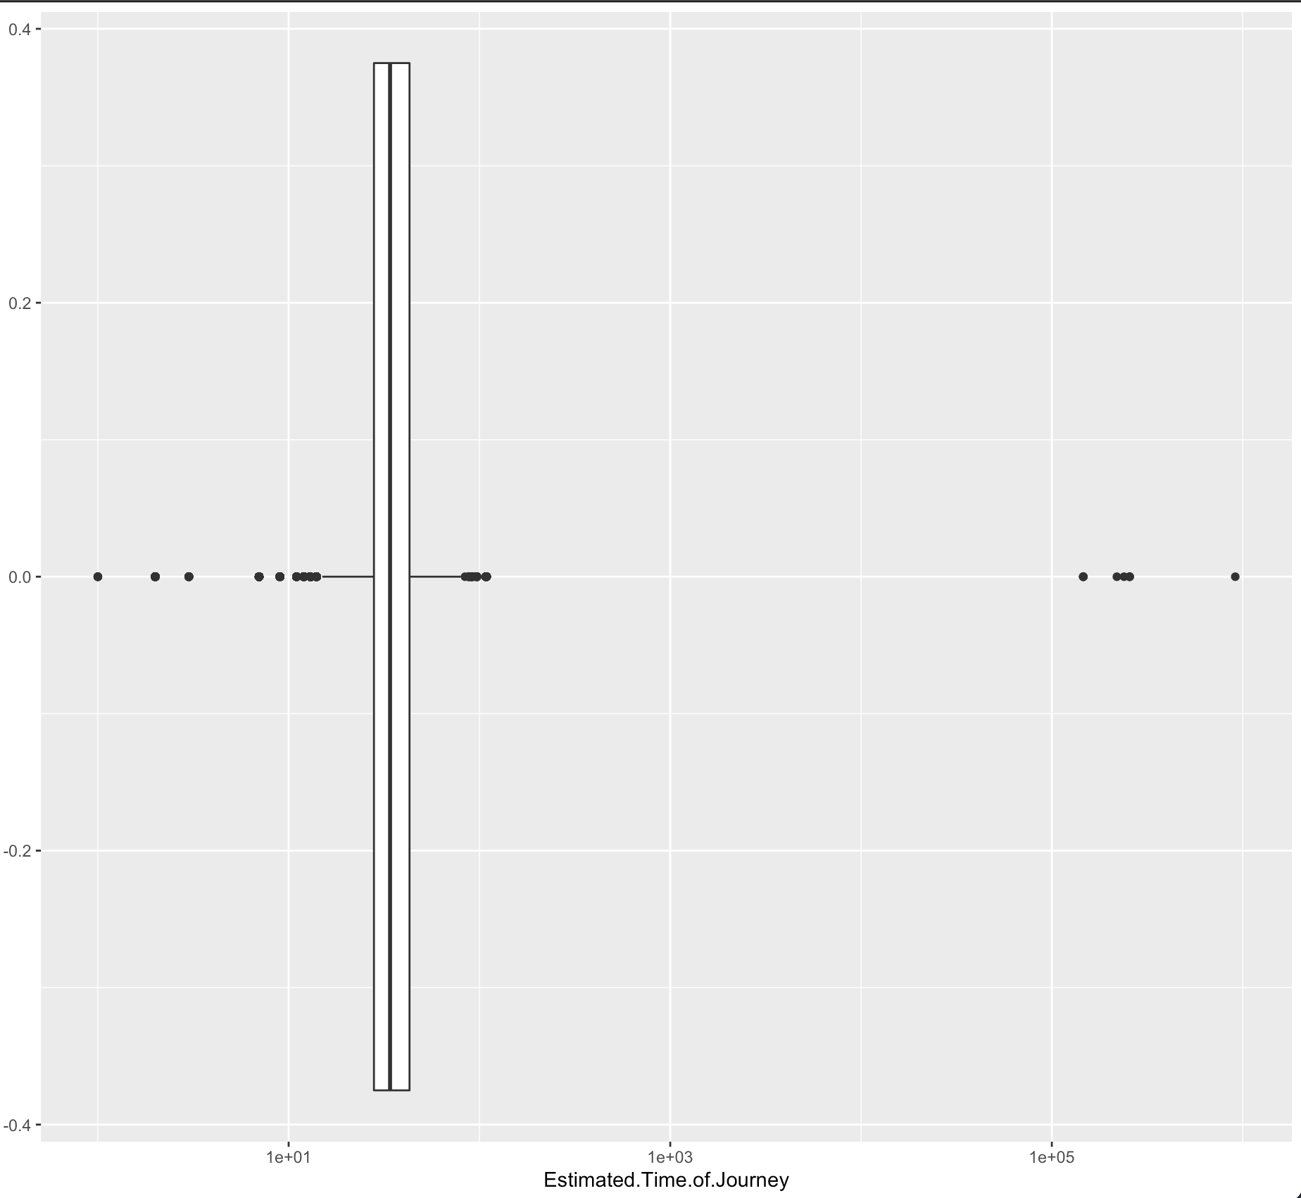
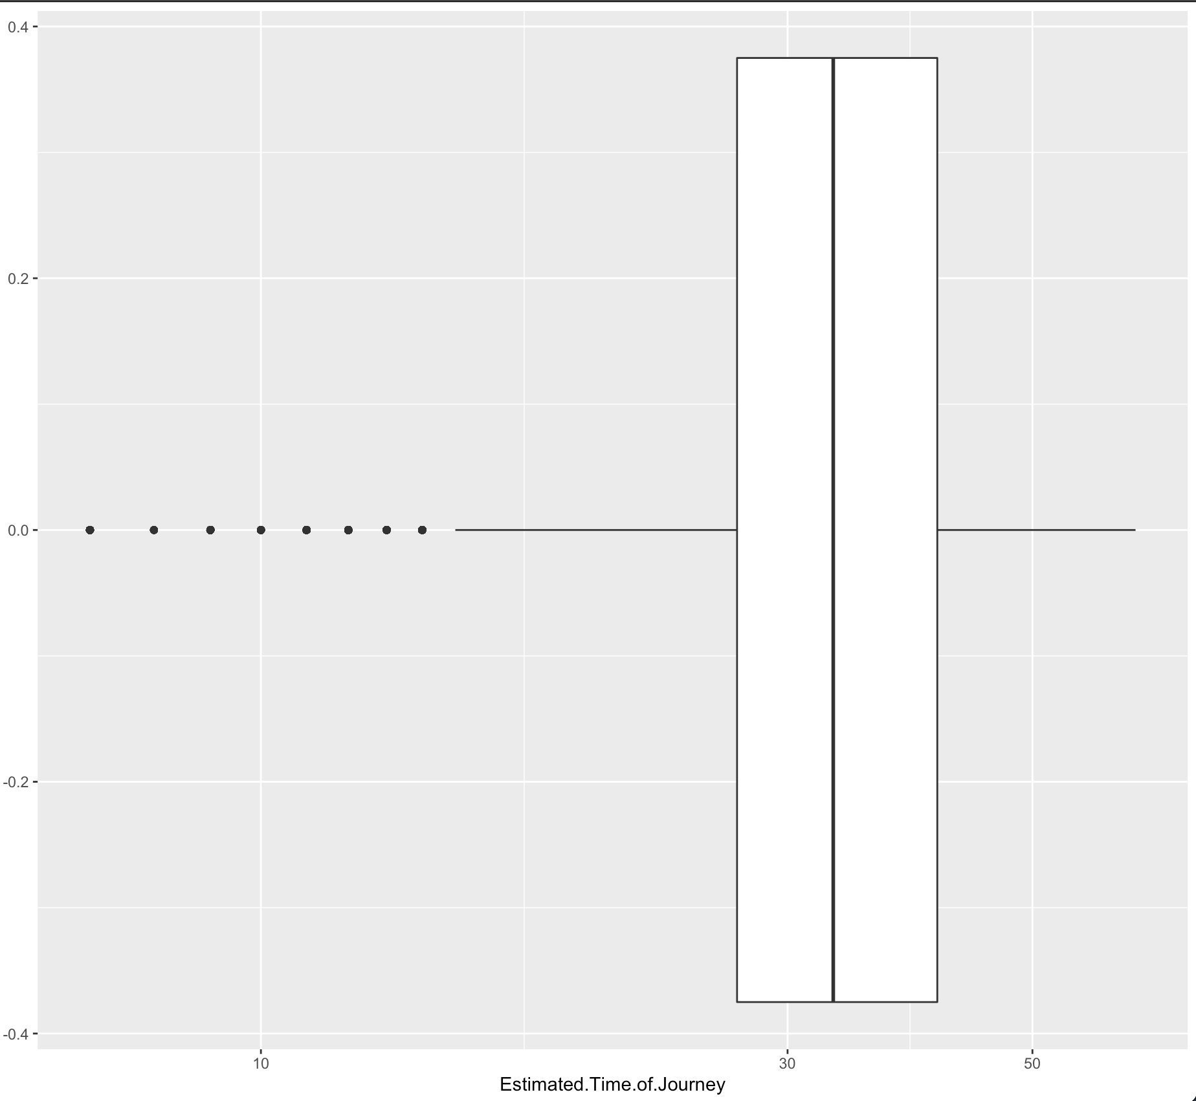
Got rid of significant outliers in
Estimated Time of Journey

Slide 8
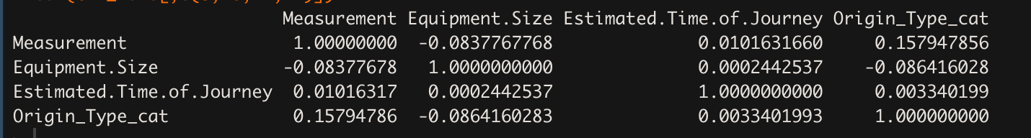
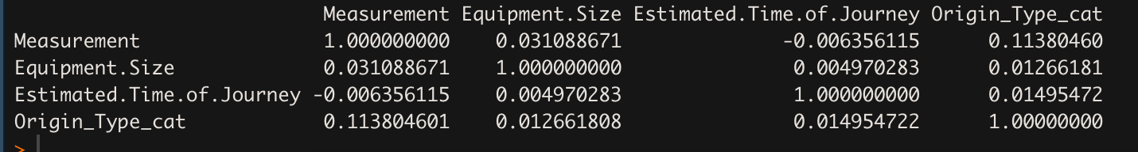
Home Goods + Home Depot
Everything else

Slide 9
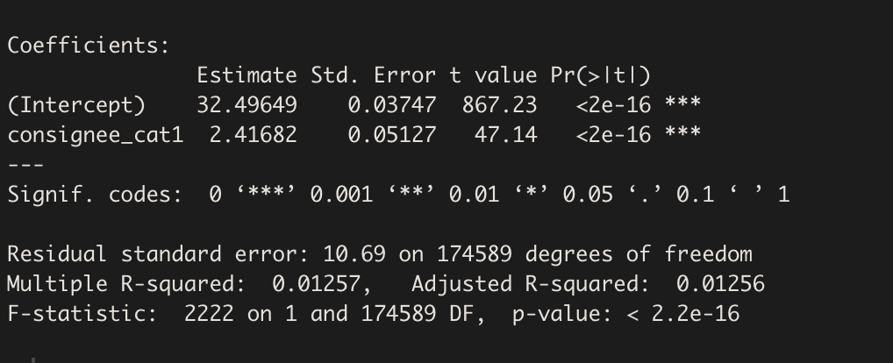
Linear Regression Model
Notes:
1 = Home Depot & Home Goods
0 = other consignees
Were other consignees better than home depot/home good in terms of estimated journey time? Did they have a longer journey or shorter?
Positive correlation - model is significant - home depot & home good had longer journey times

Slide 10
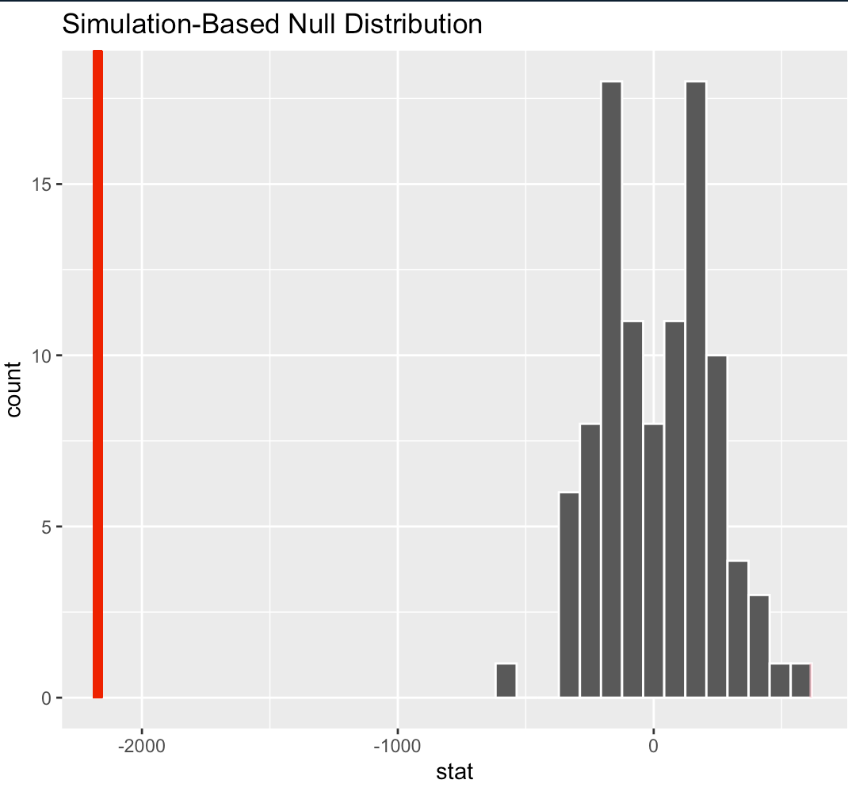
Hypothesis Testing
Null hypothesis: Consignees does not affect journey time
Alternate hypothesis: Homegood/homedepot has higher journey time than other Consignees
P-value ~ 0, we reject null hypothesis

Slide 11
Business Insights & Recommendations
Recognized a problem with specifically Home Depot & Home goods - taking a longer journey time than other consignees
Home Depot buying its own container ship - worth looking into if they’re a good client to hold on to? Look into revenue.
What can Maersk do to better their relationship with Home Depot & Home Goods? Further Analysis
We clearly see a higher journey time when they’re involved → potentially the reason why they’re diversifying to other methods to ship
Prioritize faster shipping for these 2 companies if they wanted to hold onto them as clients

Slide 12
Further Analysis:
If we had more time we would have:
Narrowed the data set even more (looking into set paths between cities)
Look more into Home Depot and what might factors may affect estimated shipment times
Equipment Type, Origin Type, Measurement

